Slide 1



Promoting Financial Products to Bank Customers From a Prescriptive Analytics Perspective
Machine Learning Under a Optimization Lens Final Project
Luca-Andrei Manea, Zeki Yan

Slide 2








Problem statement
Customer Interests
Marketing Channel
Savings account
Gift
Mortgage account
Newsletter
Prediction
Pension account
Seminar
TO BE DECIDED
Contact which customers?
Promote which product?
Decision
Through which channel?

Slide 3
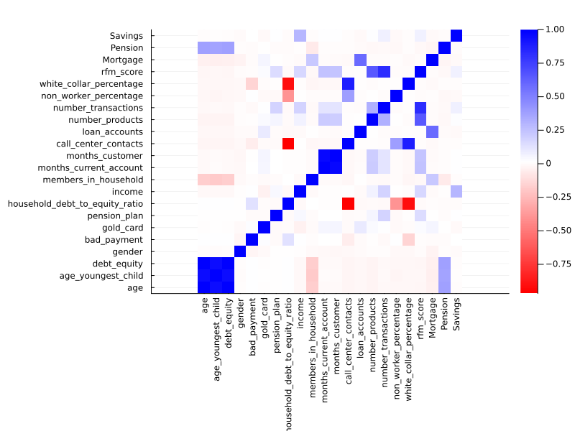
EDA & Feature Engineering
Moderate correlation with target variables overall
Savings account:
Income (0.2987)
Pension account:
Age (0.3814)
Age of Youngest Child (0.3814)
Debt-to-Equity Ratio (0.3814)
All correlated with each other
Mortgage account:
# Loan accounts (0.5916)
# Household members (0.2278)

Slide 4
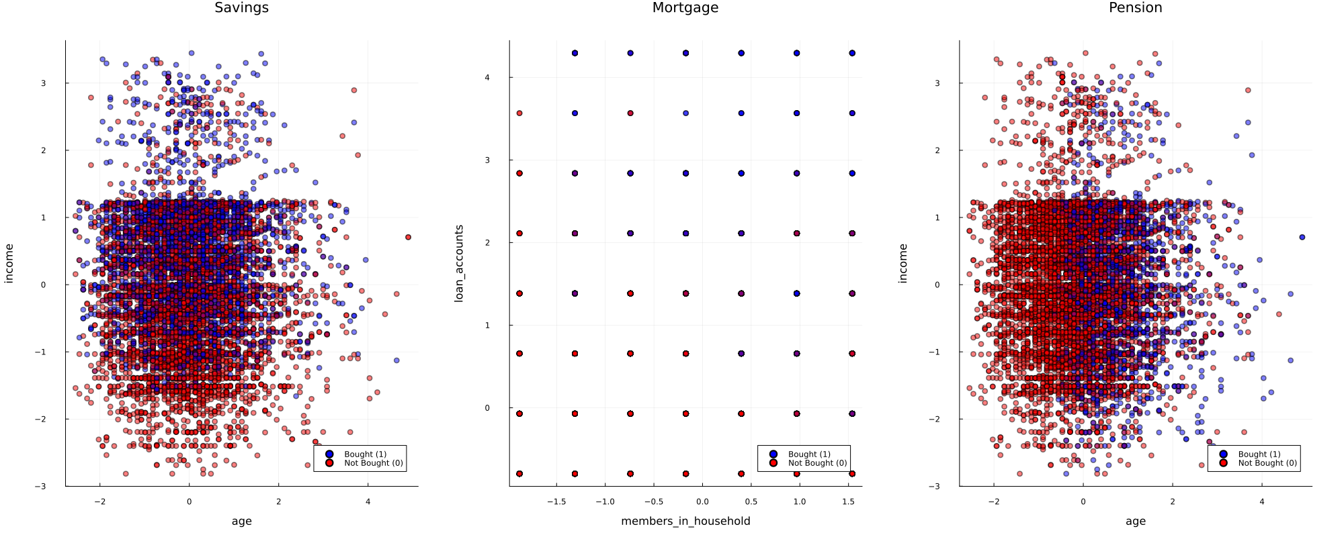
EDA & Feature Engineering
Selected Features: Age, Income, Number of members in household, Number of loan accounts

Slide 5
Methodology & Prediction models
METHODS
MODELS
Sample Average
Greedy Algorithm
Random Forest
Sample Average Approximation
XGBoost
Optimal Classification Tree
Point Prediction
Logistics Regression
K-Nearest Neighbor
Predictive Prescription
Kernel Methods

Slide 6
greedy method | serve as baseline
Greedy Algorithm (simplified pseudo code)
for customers from 1 to I:
for products from 1 to J:
for channels from 1 to K:
if (predicted) demand is not satisfied:
make an assignment!

Slide 7
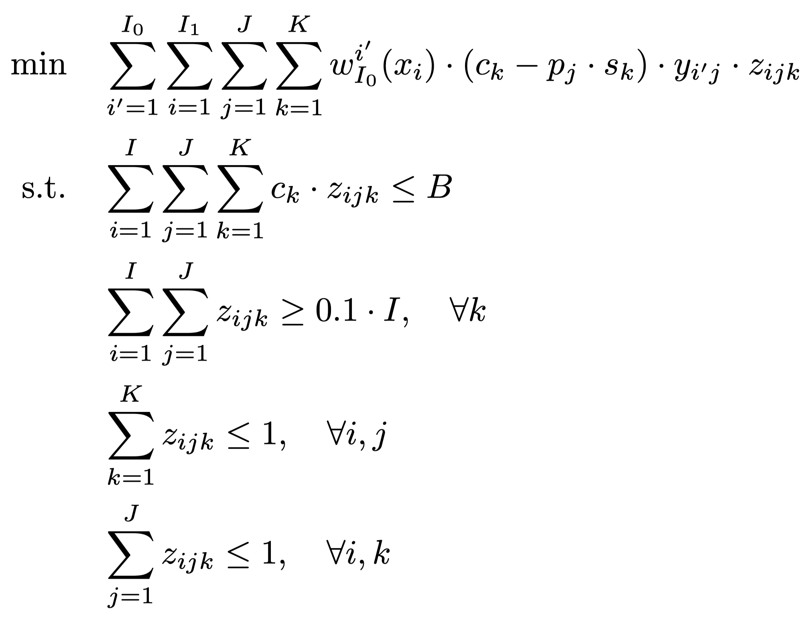
Optimization method | e.g. Prescriptive
Minimize minus expected profit
Budget Constraint
Minimum promotion per channel constraint
At most one channel per customer
At most one product per customer

Slide 8
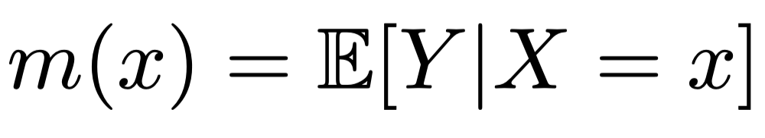
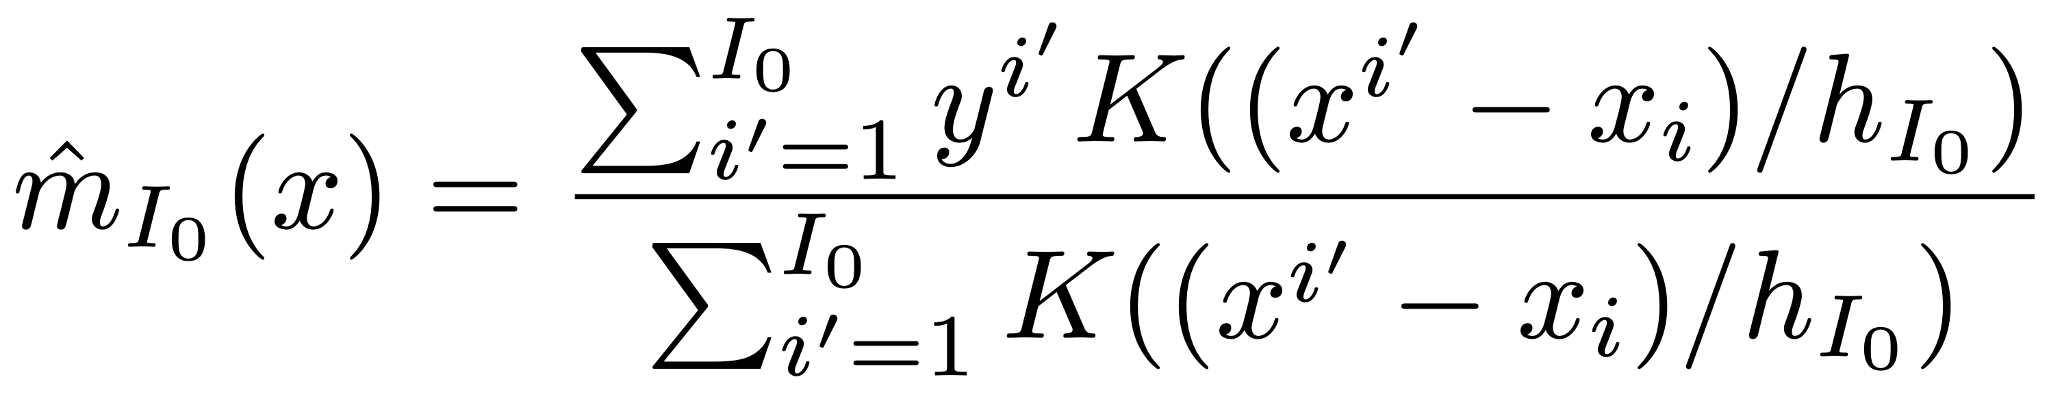
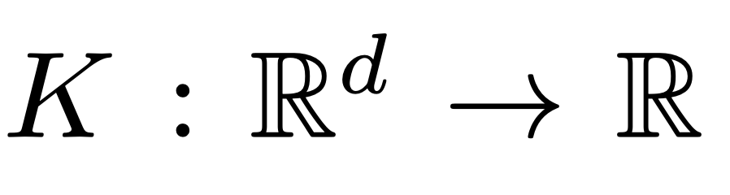
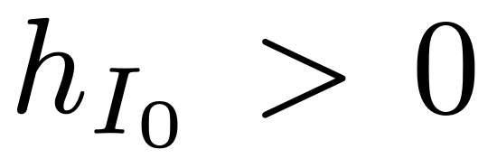
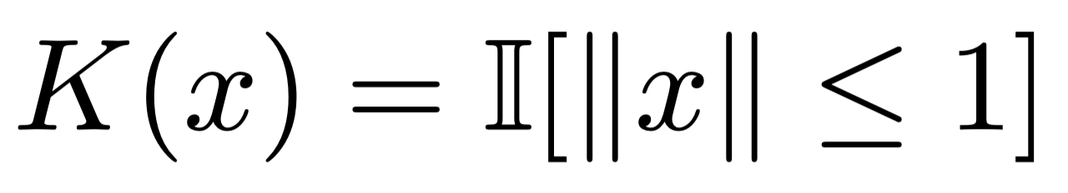
Weighting model | e.g. kernel methods
To Estimate:
Kernel
Bandwidth
Naive Kernel

Slide 9
Result | best model: Predictive prescription powered by kernel methods
Profit generated by each method & model
50
46.3
40.9
Random Forest
45
XGBoost
40
38.8
OCT
Logistics Regression
35
31.4
32.8
KNN
30
Kernel Method
25
20
14.0
15.0
15.6
15
13.3
10
5
3.0
0
Unit: $K
Greedy Algorithm
Point Prediction
Prescriptive

Slide 10
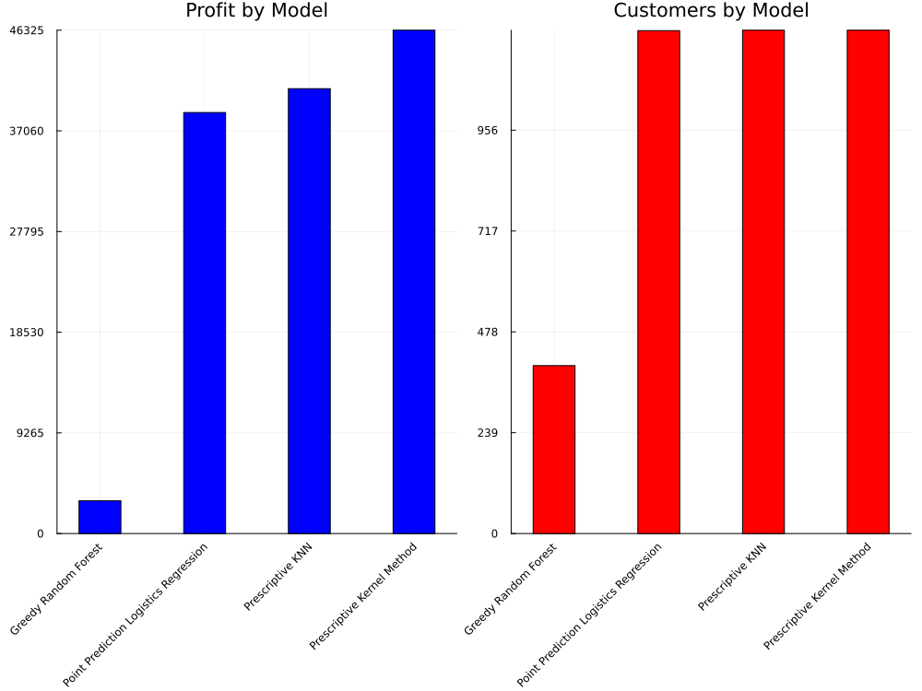
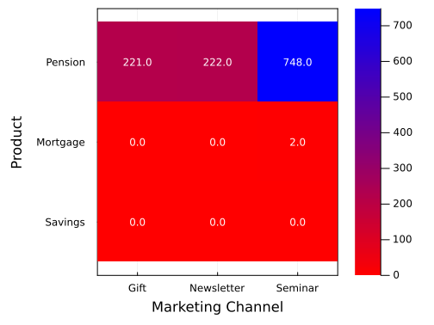
Result | metric Analysis
Comparison of Profitability
and Offering Ability
Product Offering Channels (Prescriptive Kernel Method)
Better models serve more customers
Best model prioritizes profitable products/channels

Slide 11
Business Impact | significant improvement
+35,004
+596
25,000
25,000
0
+119.6%
+99.8%
+309.1%
Unused
Used
Greedy Algorithm (Average)
Predictive Prescription (Kernel)
Greedy Algorithm (Average)
Predictive Prescription (Kernel)
Greedy Algorithm (Average)
Predictive Prescription (Kernel)
$ Profit Generated
X 3
$ Budget Utilized
X 2
# Customers Served
X 2

Slide 12
THANK YOU!

Slide 13
referenceS
[1] Bertsimas, Dimitris, and Jack Dunn. "Optimal classification trees." Machine Learning 106 (2017): 1039-1082.
[2] Bertsimas, Dimitris, and Nathan Kallus. "From predictive to prescriptive analytics." Management Science 66.3 (2020): 1025-1044.
[3] Bertsimas, Dimitris, and Nihal Koduri. "Data-driven optimization: A reproducing kernel Hilbert space approach." Operations Research 70.1 (2022): 454-471.
[4] Bertsimas, Dimitris, and Kimberly Villalobos Carballo. "Multistage Stochastic Optimization via Kernels." arXiv preprint arXiv:2303.06515 (2023).

Slide 14
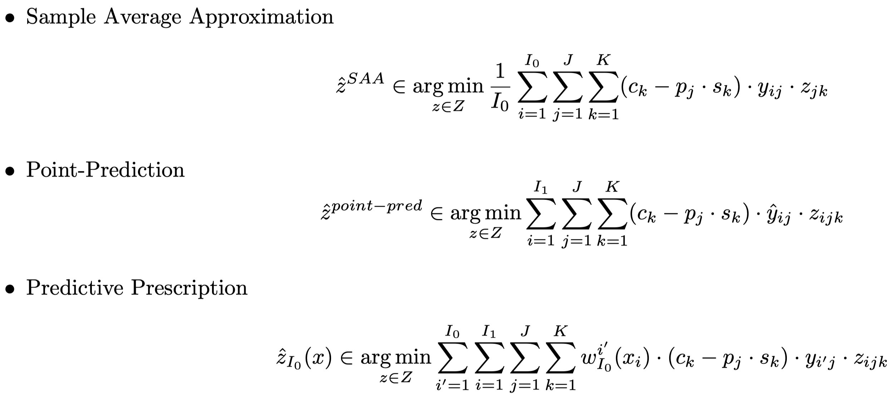
Appendix 1 | Objective functions

Slide 15
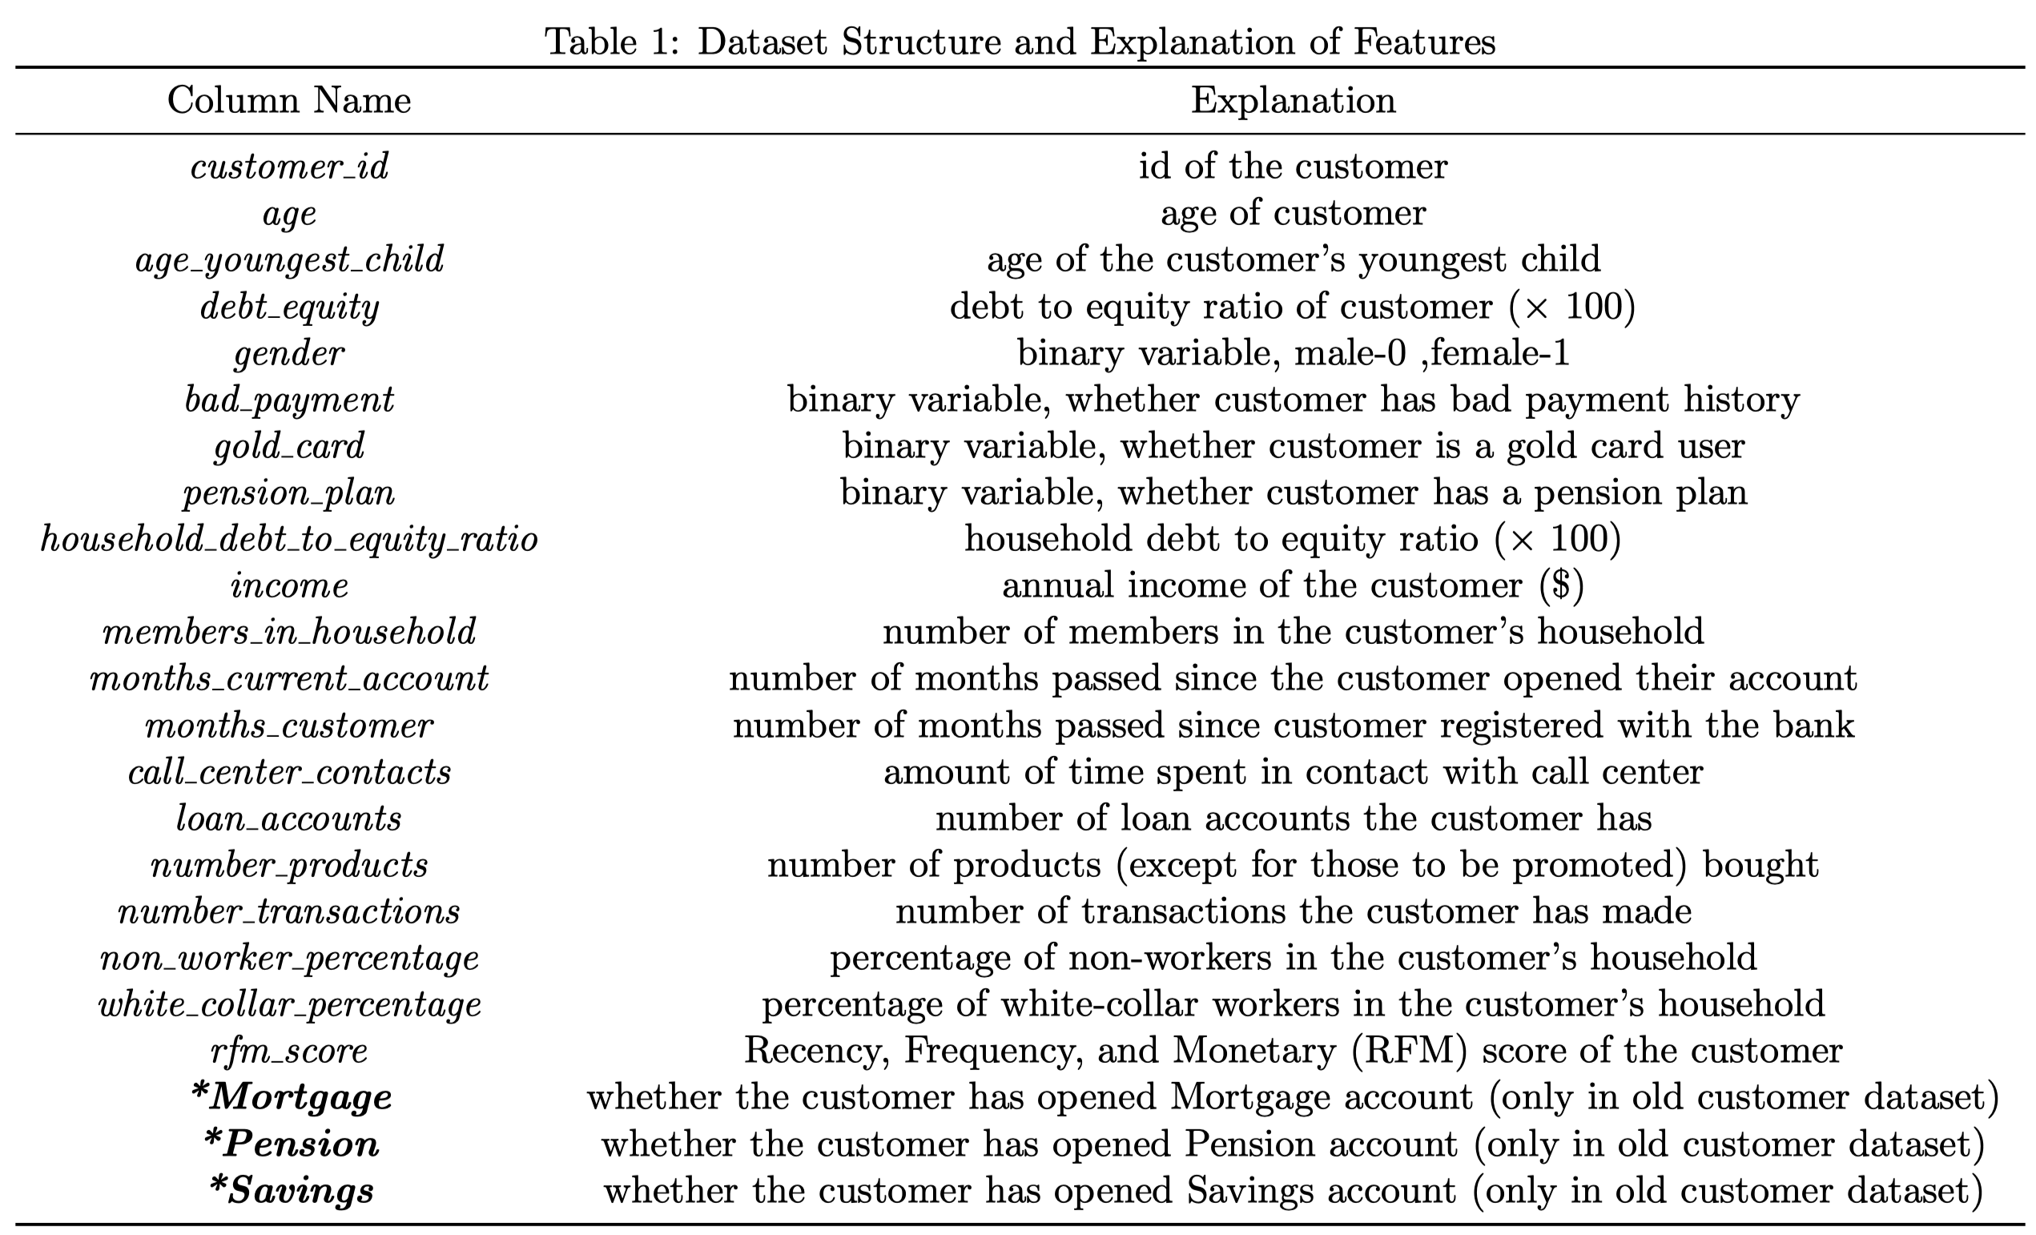
Appendix 2 | Data structure

Slide 16
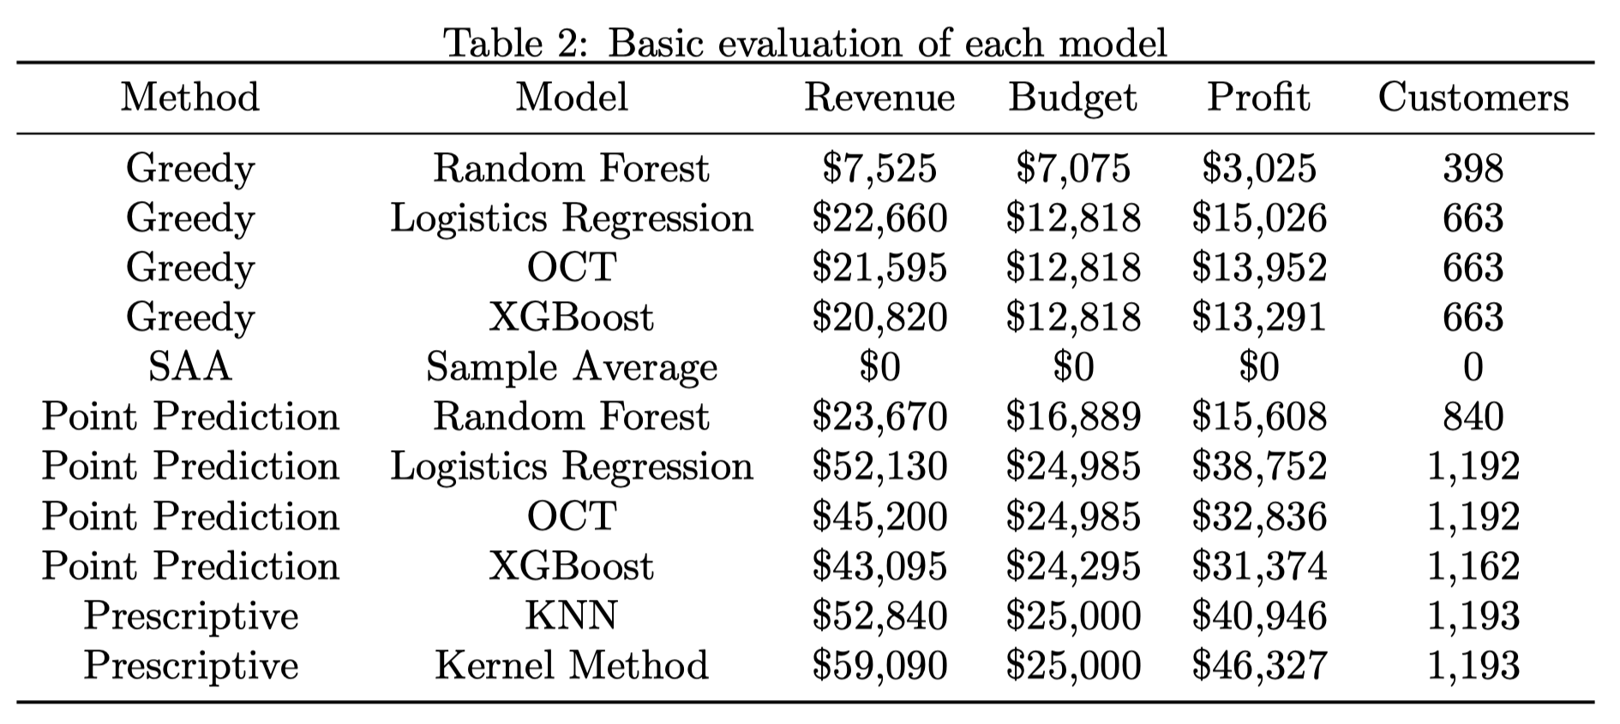
Appendix 3 | Model basic evaluation

Slide 17
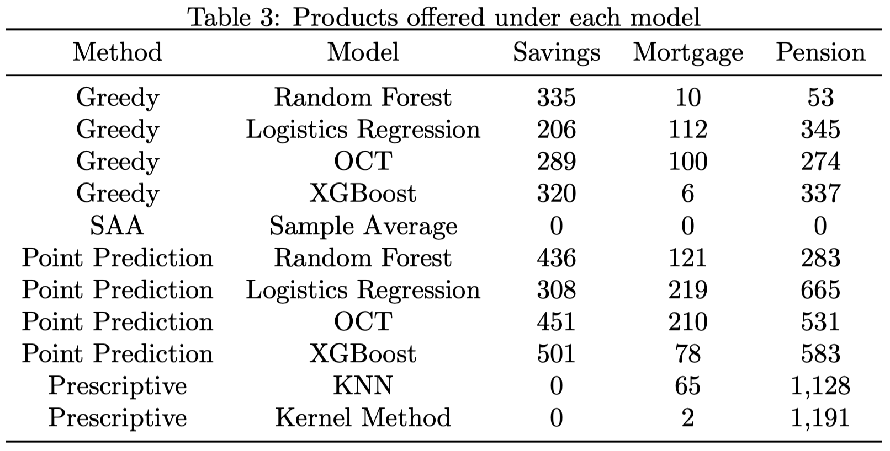
Appendix 4 | Products offer results

Slide 18
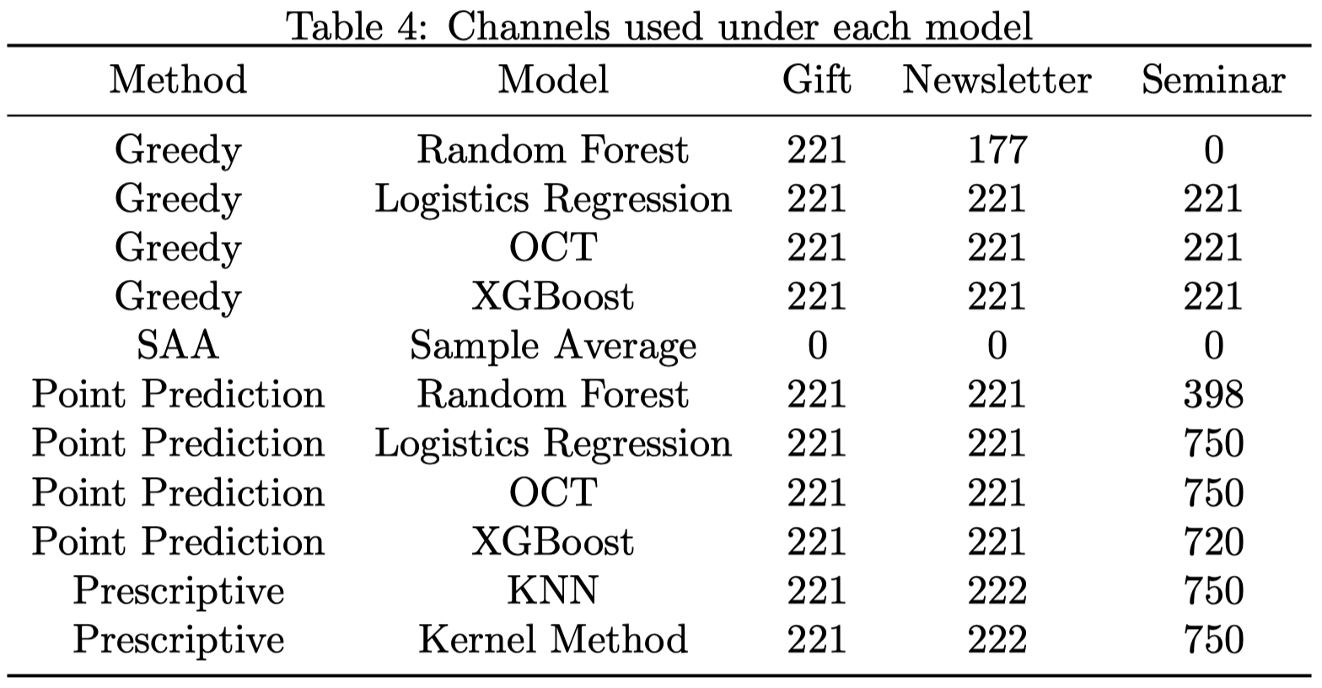
Appendix 5 | channels used results

